Slide 1
How to recommand Airbnb price?
Ziqiao Liu

Slide 2

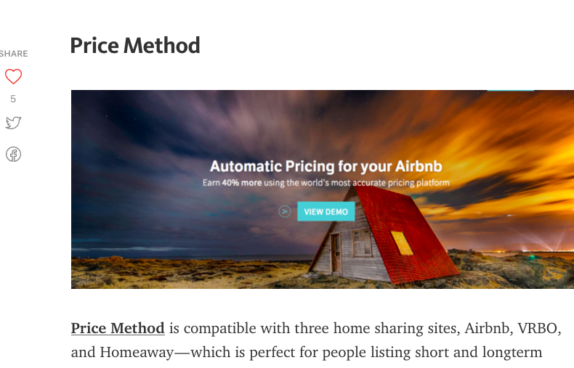
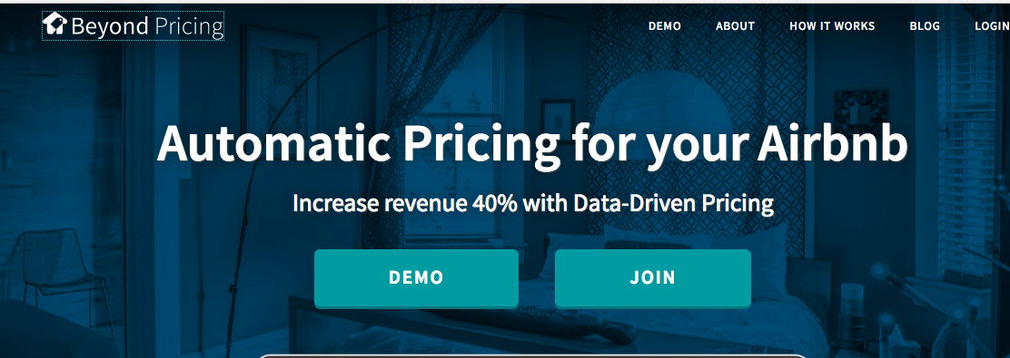
How to Help Setting Price for Airbnb Landlord?

Slide 3


Web Scraping Popular Hotel Website to Get a Hint for Trend!
Destination: Orlando, FL Dates: Dec 23 2016 ---- Dec 27 2016

Slide 4
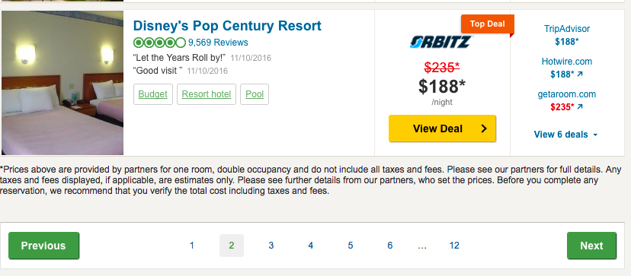
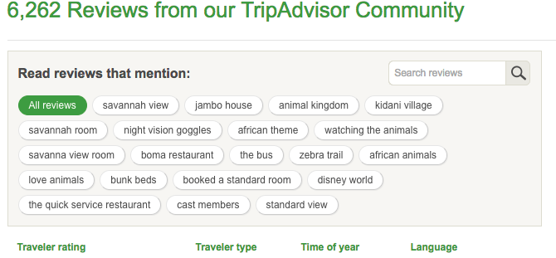
TripAdvisor Scraping

Slide 5
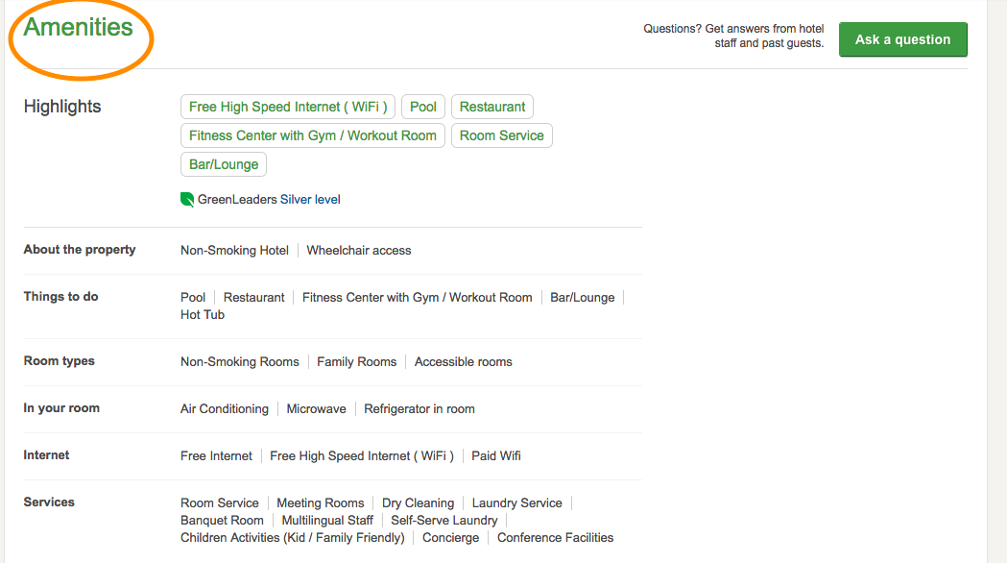
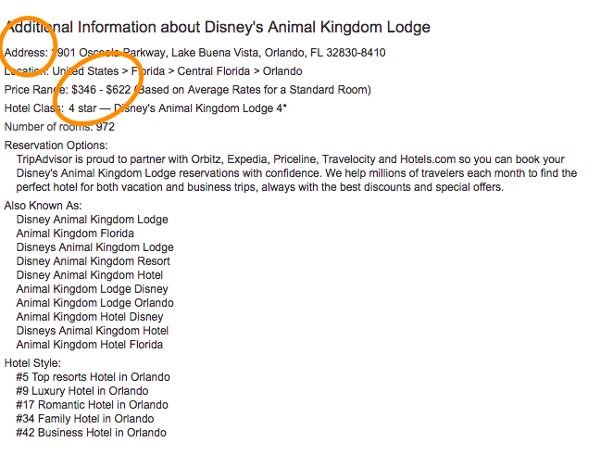

Slide 6
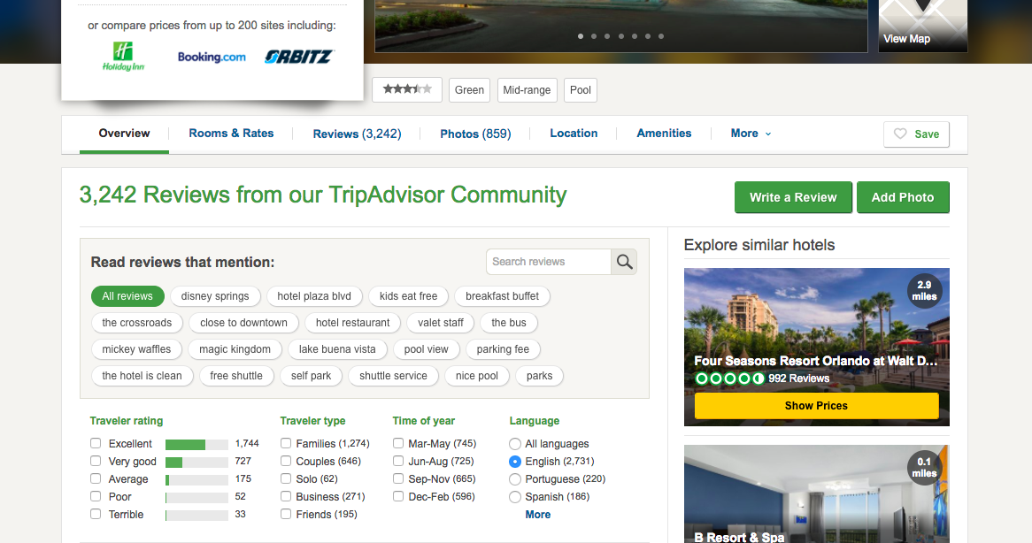

Slide 7
Scraping Results from Aribnb and TripAdvisor
Airbnb: 262 observations, 52 variables
instant_book , rating_checkin , person_capacity , rating_cleanliness ,tax ,lon, lat, cancel_policy, price , lat, host_id , review_score, review count , bed_type, accuracy_rating , rating_communication, satisfaction_guest, hosting_id , url ,cleaning_fee, room_type and 29 Amenities

Slide 8
Scraping Results from Aribnb and TripAdvisor
TripAdvisor: 233 observations, 53 variables
instant_book , rating_checkin , person_capacity , rating_cleanliness ,tax ,lon, lat, cancel_policy, price , lat, host_id , review_score, review count , bed_type, accuracy_rating , rating_communication, satisfaction_guest, hosting_id , url ,cleaning_fee, room_type and 29 Amenities

Slide 9
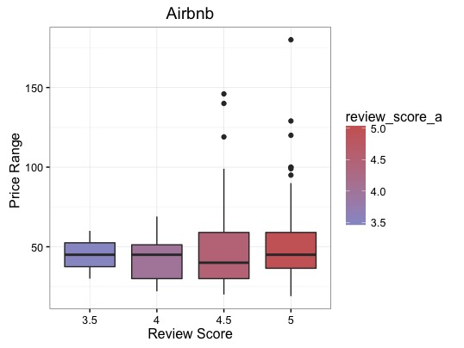

Slide 10
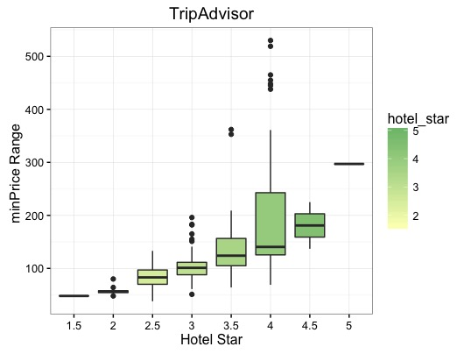
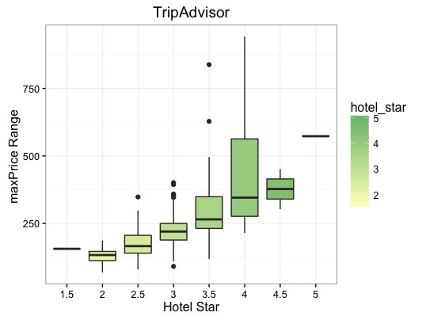

Slide 11
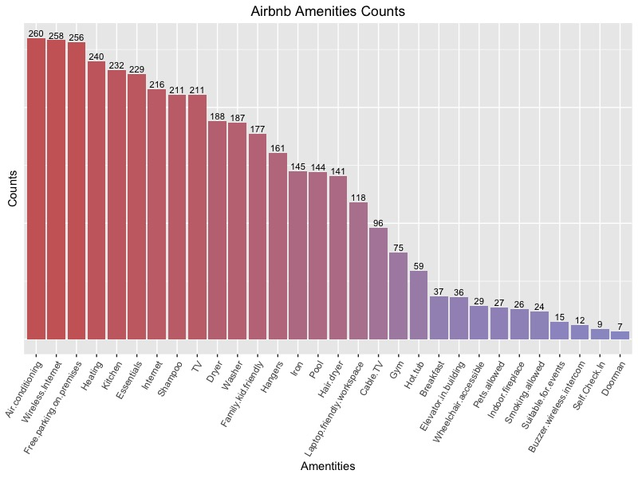

Slide 12
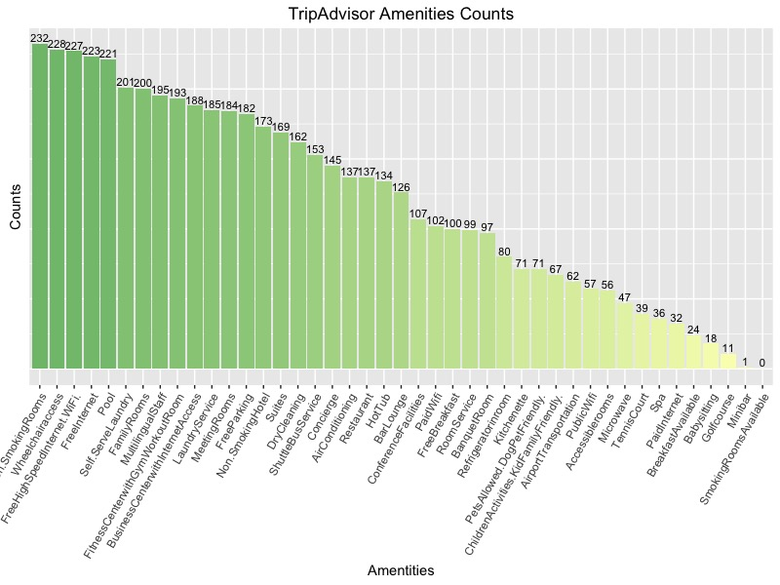

Slide 13
Build a Multiple Linear Regression Model
Check model in Rmd file

Slide 14
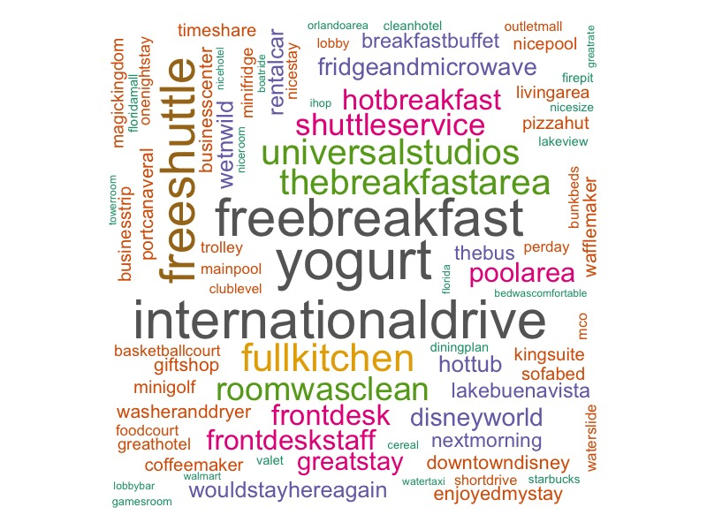
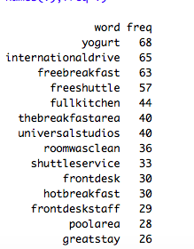
Unexpected fact

